Slide 1
Programming Assignment2
Structure-from-Motion
Prof. Hae-Gon Jeon
Notes:
hello. I'm Sang-Hoon Han, a Ph.D. student in Professor hae-gon Jeon’s lab, and I am a teaching assistant at PA2.
Lectures are given briefly in English, 그리고 여러분이 궁금할 부분을 자세히 한국어로 설명하겠습니다.

Slide 2













Recall: Coordinate System
Pixel Image Coordinate System
$$P_{c} \left(X_{c},Y_{c},Z_{c}\right) and also P(X, Y, Z)$$
Point of Camera Coordinate System
Point of World Coordinate System
$$p_{img}(x, y)$$
Normalized Image Coordinate System
$$p_{norm} (u, v)$$
$$x$$
World Coordinate System
$$u$$
$$y$$
$$Z_{C}$$
$$Z$$
$$X$$
Camera Coordinate System
$$v$$
$$X_{C}$$
$$Y_{C}$$
$$Y$$
Notes:
Let me explain the coordinate system first, In order to do geometry as well as sfm, you need to know the coordinate system transformation well.
In the geometry, There are 4 coordinate systems.
World, camera coordinate system is 3D, Norm, pixel coordinate system is 2D
Here, I will notate the uppercase P as a three-dimensional point and the lowercase p as a two-dimensional point.
좌표계 먼저 설명, sfm뿐만이 아닌 geometry를 하기위해서는 좌표계 변환을 잘 알아야한다.
1, 2, 3, 4 좌표계가 있다
World, camera 좌표계는 3차원, Norm, pixel 좌표계는 2차원
P는 3차원 점, pixel은 이미지 좌표계, norm. 은 camera center에서 z=1에 위치한 좌표계
P, P_c는 같은 점이나 어떤 좌표계에서 바라보는지에 따라 값이 다르다.

Slide 3
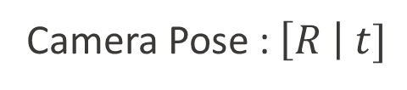
Recall: Coordinate System
$p_{norm}\left(u, v\right)$ ← $p_{img}(x, y)$ ← $P_{c}\left(X_{c},Y_{c},Z_{c}\right)$ ← $P(X, Y, Z)$
Pixel Image Coordinate System
$$P_{c} \left(X_{c},Y_{c},Z_{c}\right) and also P(X, Y, Z)$$
Point of Camera Coordinate System
Point of World Coordinate System
$$p_{img}(x, y)$$
Normalized Image Coordinate System
$$p_{norm} (u, v)$$
$$x$$
World Coordinate System
$$u$$
$$y$$
$$Z_{C}$$
$$Z$$
$$X$$
Camera Coordinate System
$$v$$
$$X_{C}$$
$$Y_{C}$$
$$Y$$
Camera Pose : $\left[R \right| t]$
Notes:
The transformation of the coordinate system for the Sfm task is done in the order of P->P_c->p_img->p_norm.
First, the camera coordinate system is expressed as a transformation of the world coordinate system through R and t.
To put it simply, you can think of the camera center as a coordinate system with the origin.
For the sfm task, you need to know how to transform the above coordinate system.
카메라 좌표계는 상대적인 개념, world 좌표계에서 [R|t]를 통해 좌표계 변환이 이루어짐
쉽게 생각해서 camera center가 원점인 좌표계라고 보면 된다.
이후에 설명의 편의를 위해 R, t을 통칭해 camera pose라고 부르겠습니다.
Sfm과제를 위한 좌표계의 변환은 P->P_c->p_img->p_norm의 순서로 이루어진다.

Slide 4

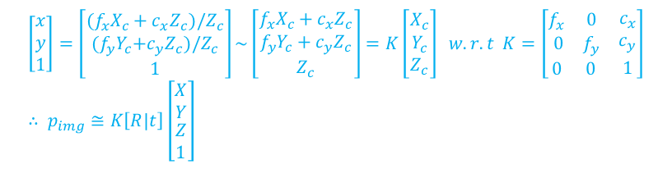
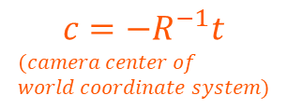
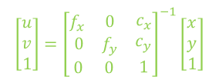

Recall: Coordinate System
$p_{norm}\left(u, v\right)$ ↔ $p_{img}(x, y)$ ← $P_{c}\left(X_{c},Y_{c},Z_{c}\right)$ ↔ $P(X, Y, Z)$
$$\left[\begin{matrix}x \\ y \\ 1\end{matrix}\right]=\left[\begin{matrix}({f_{x}X}_{c}+{c_{x}Z}_{c})/Z_{c} \\ {(f_{y}Y}_{c}+{c_{y}Z}_{c})/Z_{c} \\ 1\end{matrix}\right]\sim \left[\begin{matrix}{f_{x}X}_{c}+{c_{x}Z}_{c} \\ {f_{y}Y}_{c}+{c_{y}Z}_{c} \\ Z_{c}\end{matrix}\right]=K\left[\begin{matrix}X_{c} \\ Y_{c} \\ Z_{c}\end{matrix}\right] w.r.t K=\left[\begin{matrix}\begin{matrix}f_{x} & 0 \\ 0 & f_{y}\end{matrix} & \begin{matrix}c_{x} \\ c_{y}\end{matrix} \\ \begin{matrix}0 & 0\end{matrix} & 1\end{matrix}\right] \\ ∴ p_{img}≅K\left[R|t\right]\left[\begin{matrix}\begin{matrix}X \\ Y\end{matrix} \\ \begin{matrix}Z \\ 1\end{matrix}\end{matrix}\right]$$
$$P_{c} \left(X_{c},Y_{c},Z_{c}\right)=RP(X, Y, Z)+t$$
$$p_{norm}=K^{−1}p_{img}$$
Point of Camera Coordinate System
Point of World Coordinate System
$$\left[\begin{matrix}u \\ v \\ 1\end{matrix}\right]={\left[\begin{matrix}\begin{matrix}f_{x} & 0 \\ 0 & f_{y}\end{matrix} & \begin{matrix}c_{x} \\ c_{y}\end{matrix} \\ \begin{matrix}0 & 0\end{matrix} & 1\end{matrix}\right]}^{−1}\left[\begin{matrix}x \\ y \\ 1\end{matrix}\right]$$
$$p_{img}(x, y)$$
$$p_{norm} (u, v)$$
$$x$$
World Coordinate System
$$u$$
$$y$$
$$c=−R^{−1}t$$
$$(camera center of \\ world coordinate system)$$
$$Z_{C}$$
$$Z$$
$$X$$
$$v$$
$$X_{C}$$
$$Y_{C}$$
$$Y$$
Camera Pose : $\left[R \right| t]$
Notes:
The conversion formula is as follows.
When writing the code for the assignment, you can write the code by referring to the above formula.
Alternatively, you can easily find out about the coordinate system transformation through a search like google, so you can refer to it.
변환식은 다음과 같다.
교재/강의마다 notation 이 다른데, 3차원 점을 X로 나타내고 P=[R|t]로 표기하기도 한다.

Slide 5
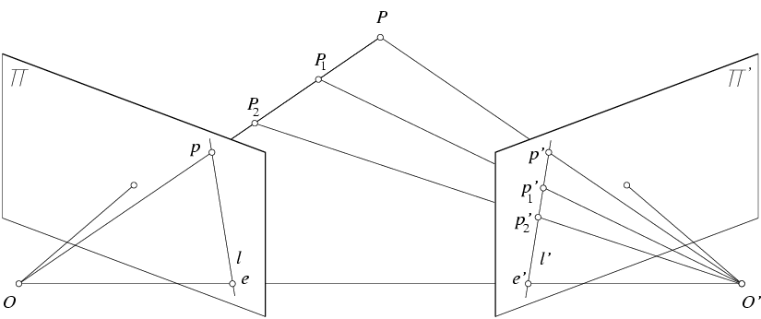
Recall: Epipolar constraint
X
X
X
x
x’
x’
x’
Potential matches for x have to lie on the corresponding line l’.
Potential matches for x’ have to lie on the corresponding line l.
Notes:
The second is the epipolar constraint.
In simple terms, this means that the pixel x observed by the left camera is constrained to lie on the 1d line in the right camera.

Slide 6
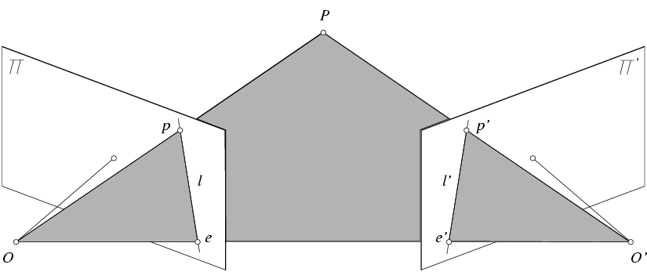
Recall: Epipolar geometry notation
X
x
x’
Baseline – line connecting the two camera centers
Epipoles
= intersections of baseline with image planes
= projections of the other camera center
Epipolar Plane – plane containing baseline (1D family)
Notes:
Let me briefly explain epipolar geometry notation.
It is a plane consisting of 3d point X and two camera centers O, O’, also which contains the baseline.

Slide 7
Recall: Epipolar geometry notation
X
x
x’
Baseline – line connecting the two camera centers
Epipoles
= intersections of baseline with image planes
= projections of the other camera center
Epipolar Plane – plane containing baseline (1D family)
Epipolar Lines - intersections of epipolar plane with image planes (always come in corresponding pairs)

Slide 8
Recall: Properties of the Essential matrix
X
x
x’
Drop ^ below to simplify notation
E x’ is the epipolar line associated with x’ (l = E x’)
E^{T}x is the epipolar line associated with x (l’ = E^{T}x)
E e’ = 0 and E^{T}e = 0
E is singular (rank two)
E has five degrees of freedom
(3 for R, 2 for t because it’s up to a scale)
Skew -symmetric matrix
Notes:
The formula for the essential matrix is as follows.
The first thing to note is that x is a point in the normalized image coordinate system.
The most important thing to look at is the middle expression, xEx=0,
The point is that if we multiply each coordinate by the essential matrix for x and x' projected by the camera at the same 3d point X, we get 0.
Also, the essential matrix is expressed as the cross product of the rotation matrix and translation. This will be needed later for essential matrix decomposition.
xEx는 pixel과 사영된 line의 거리를 의미, decomposition은 나중에 설명 (중요)
Normalized image coordinate
https://www.cs.rice.edu/~vo9/vision/slides/lecture11.pdf

Slide 9
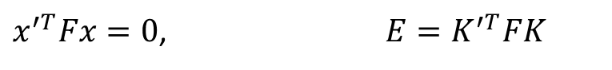
Recall: Properties of the Fundamental matrix
X
x
x’
$x^{′T}Fx=0$, $E=K^{′T}FK$
F x’ is the epipolar line associated with x’ (l= Fx')
F^{T}x is the epipolar line associated with x (l’= F^{T}x)
F e’ = 0 and F^{T}e = 0
F is singular (rank two): det(F)=0
F has seven degrees of freedom: 9 entries but defined up to scale, det(F)=0
Notes:
The fundamental matrix is obtained in pixel image coordinates.
Similar to the essential matrix, this also satisfies the formula of xTFx=0.
Also, the fundamental matrix is closely related to the essential matrix described earlier, and the essential matrix can be obtained through the intrinsic parameter.

Slide 10
Recall: Estimating the Fundamental Matrix
8-point algorithm
Least squares solution using SVD on equations from 8 pairs of correspondences
Enforce det(F)=0 constraint using SVD on F
7-point algorithm
Use least squares to solve for null space (two vectors) using SVD and 7 pairs of correspondences
Solve for linear combination of null space vectors that satisfies det(F)=0
Minimize reprojection error
Non-linear least squares
Note: estimation of F (or E) is degenerate for a planar scene.
Notes:
It has nothing to use with the sfm task, but if I explain it with knowledge,
There are 8-point algorithm and 7-point algorithm to obtain the fundamental matrix.
Both methods are methods of inferring F through SVD by setting up a linear combination equation with 8 or 7 matched pixel coordinates as input.

Slide 11
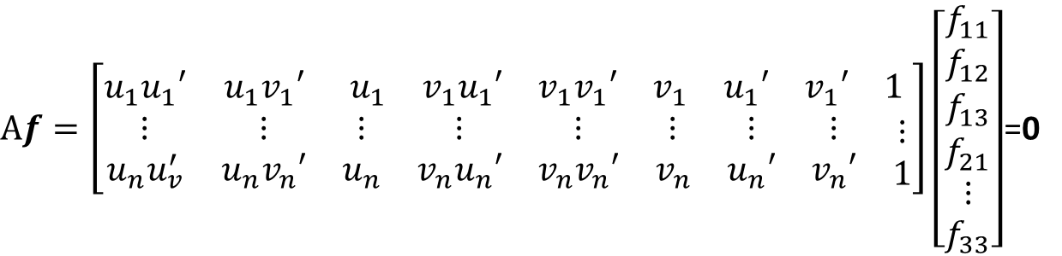
Recall: 8-point algorithm
Solve a system of homogeneous linear equations
Write down the system of equations
$$uu^{′}f_{11}+uv^{′}f_{12}+uf_{13}+vu^{′}f_{21}+vv^{′}f_{22}+vf_{23}+u^{′}f_{31}+v^{′}f_{32}+f_{33}=0$$
$Af=\left[\begin{matrix}u_{1}u_{1}′ & u_{1}v_{1}′ & \begin{matrix}u_{1} & v_{1}u_{1}′ & \begin{matrix}v_{1}v_{1}′ & v_{1} & \begin{matrix}u_{1}′ & v_{1}′ & 1\end{matrix}\end{matrix}\end{matrix} \\ \begin{matrix}⋮ \\ u_{n}u_{v}^{′}\end{matrix} & \begin{matrix}⋮ \\ u_{n}v_{n}′\end{matrix} & \begin{matrix}\begin{matrix}⋮ \\ u_{n}\end{matrix} & \begin{matrix}⋮ \\ v_{n}u_{n}′\end{matrix} & \begin{matrix}\begin{matrix}⋮ \\ v_{n}v_{n}′\end{matrix} & \begin{matrix}⋮ \\ v_{n}\end{matrix} & \begin{matrix}\begin{matrix}⋮ \\ u_{n}′\end{matrix} & \begin{matrix}⋮ \\ v_{n}′\end{matrix} & \begin{matrix}⋮ \\ 1\end{matrix}\end{matrix}\end{matrix}\end{matrix}\end{matrix}\right]\left[\begin{matrix}f_{11} \\ f_{12} \\ \begin{aligned}f_{13} \\ f_{21} \\ ⋮ \\ f_{33}\end{aligned}\end{matrix}\right]$=0
Notes:
The detailed description of the 8-point algorithm is as follows.
When we solve the xFx=0 expression just described, we get the equation below.
If we get an equation from all 8 input coordinates and stack them to form a matrix, we get a matrix for the linear equation solver like this:
왼쪽이 A, 오른쪽이 fundamental matrix의 각 요소를 가진 f

Slide 12
Recall: 8-point algorithm
Solve a system of homogeneous linear equations
Write down the system of equations
Solve f from Af=0 using SVD
Resolve det(F) = 0 constraint using SVD
Matlab:
[U, S, V] = svd(A);
f = V(:, end);
F = reshape(f, [3 3])’;
Matlab:
[U, S, V] = svd(F);
S(3,3) = 0;
F = U*S*V’;
Notes:
After decomposing the above expression through svd,
obtaining an eigenvector with a similar eigen value and making it into a matrix becomes a fundamental matrix.
Additionally, to give the condition of Determinant=0, we can make F more robust by transforming it as follows:

Slide 13
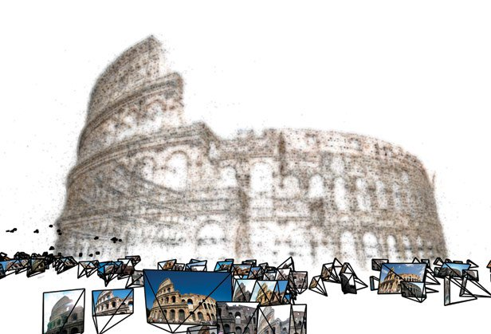
Structure from Motion
Chapter 7 in Szeliski
Notes:
Then I will explain the process of solving sfm.
This task is conducted in python and matlab.
we recommend to do the task in matlab, but since you are familiar with python, I will explain how to do it with python as well.

Slide 14
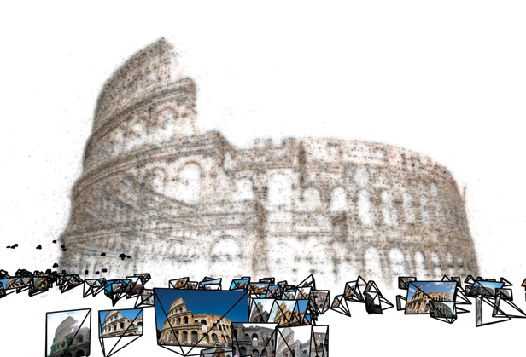
What is SfM?
Structure from Motion (SfM)
The process of estimating three-dimensional structures from two-dimensional image sequences which may be coupled with local motion signals.
Input: Freely taken images with overlapped scenery
Output: camera pose and 3D structure of the scene
Reference
http://photosynth.net
N.Snavely et al., “Photo Tourism: Exploring
photo collections in 3D”, SIGGRAPH 2006
Notes:
The process of estimating three-dimensional structures from two-dimensional image sequences which may be coupled with local motion signals.
As input, we need pictures taken from multiple directions of the same object.
The output is camera pose and 3D structure of the scene, camera rotation, translation, and 3d points as notation.

Slide 15
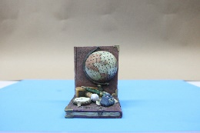
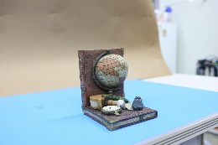
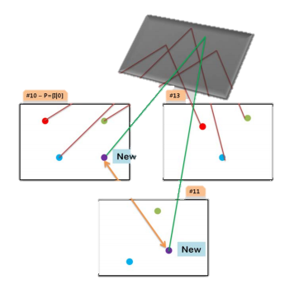

Overall Strategy
ToDo
Two images from dataset
(Two-view)
Initialization Step
( > Three-view)
Growing Step
Bundle Adjustment
[2] Hartley, Richard, and Andrew Zisserman. Multiple view geometry in computer vision. Cambridge university press, 2003.
[3] Szeliski, Richard. Computer vision: algorithms and applications. Springer Science & Business Media, 2010.
Notes:
Here's an overview:
First of all, the object is photographed from several directions.
Then, after extracting feature points from the photographed object, they are matched.
Finally, it is the process of obtaining the pose and 3d point coordinates of two cameras using the matched points.
우선 여러방향에서 물체를 촬영합니다.
그후 촬영한 물체에서 feature point를 추출 후 , 이들을 matching합니다.
마지막으로, matching된 포인트들을 이용해 두 카메라의 pose와 3d point 좌표를 구하는 과정입니다.

Slide 16
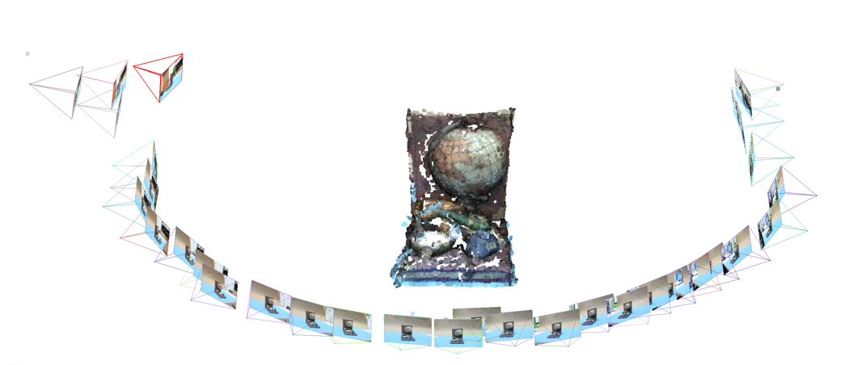
Output
Goal: Build a 3D & Estimate camera poses, given the set of images
Notes:
If you attach a few more images here, you can get a 3d structure of the whole model as follows.
하지만 이 과정은 추가점수를 위한 과정이고, 우선 pa2는 2-view만 붙이는 것으로 하겠습니다.

Slide 17
Overall Strategy
What are given?
1. 3D points reconstructed from two images
2. 2D keypoints from each image corresponding to the reconstructed 3D points
3. Camera poses of two images
Intrinsic matrix, remaining images(about 10 images)…etc
What have to be done?
1. Repeatedly reconstruct remaining images to the initialized model
2. Do Bundle Adjustment to refine 3D reconstruction result.
Notes:
Here are the details of the whole process:
Let me explain these things slowly.

Slide 18
Overall Strategy
1. Repeatedly reconstruct remaining image to the initialized model
So called Growing Step
Algorithms are as follows:
1. Select a image from remaining images whose the number of matched keypoints with reconstructed keypoints are largest.
2. estimate a camera pose of a selected image using 3-point PnP RANSAC
3. reconstruct 3D points from keypoints from pose of the selected image and a pose of reconstructed image using triangulation
4. repeat 1~3 until every images is included
Notes:
Here are the details of the whole process:
Let me explain these things slowly.

Slide 19
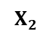
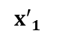
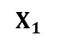
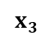
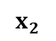
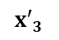
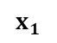
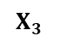
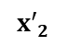
Overall Strategy
1-1. Select a image from remaining images whose the number of matched keypoints with reconstructed keypoints are largest.
$$X_{2}$$
$$X_{1}$$
$$X_{3}$$
New_image
$${x′}_{2}$$
Reconstructed
Images
$$x_{2}$$
$${x′}_{1}$$
$${x′}_{3}$$
$$x_{1}$$
1. Extract features
$$x_{3}$$
Cam2
Cam1
2. Match features with x1, x2, x3
Notes:
Here are the details of the whole process:
Let me explain these things slowly.

Slide 20
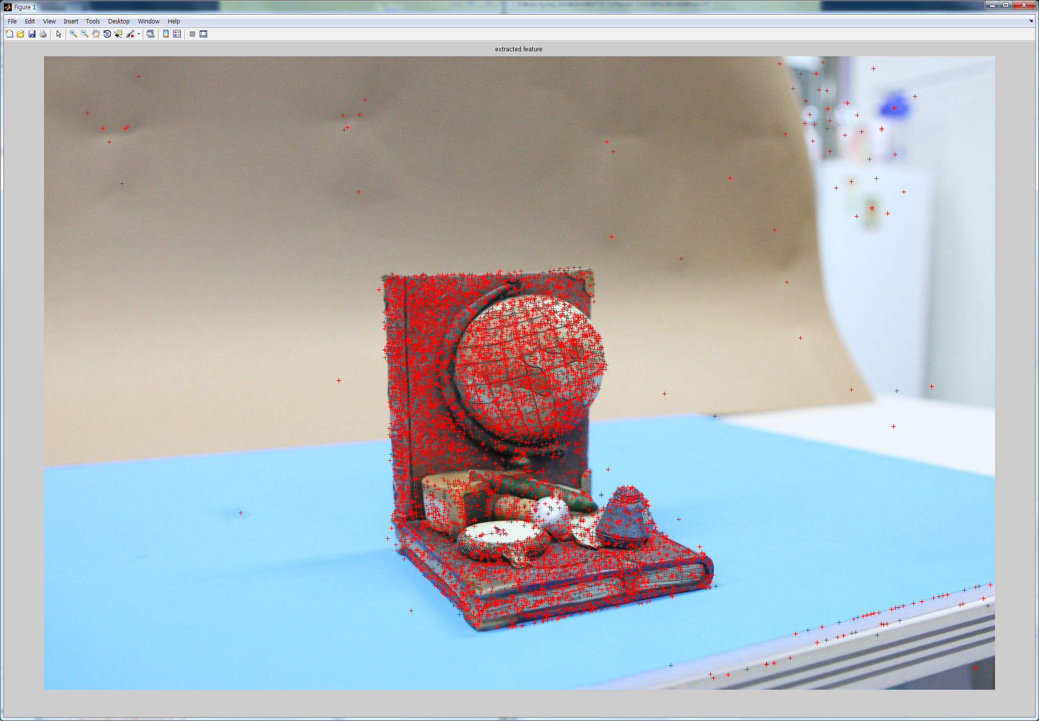
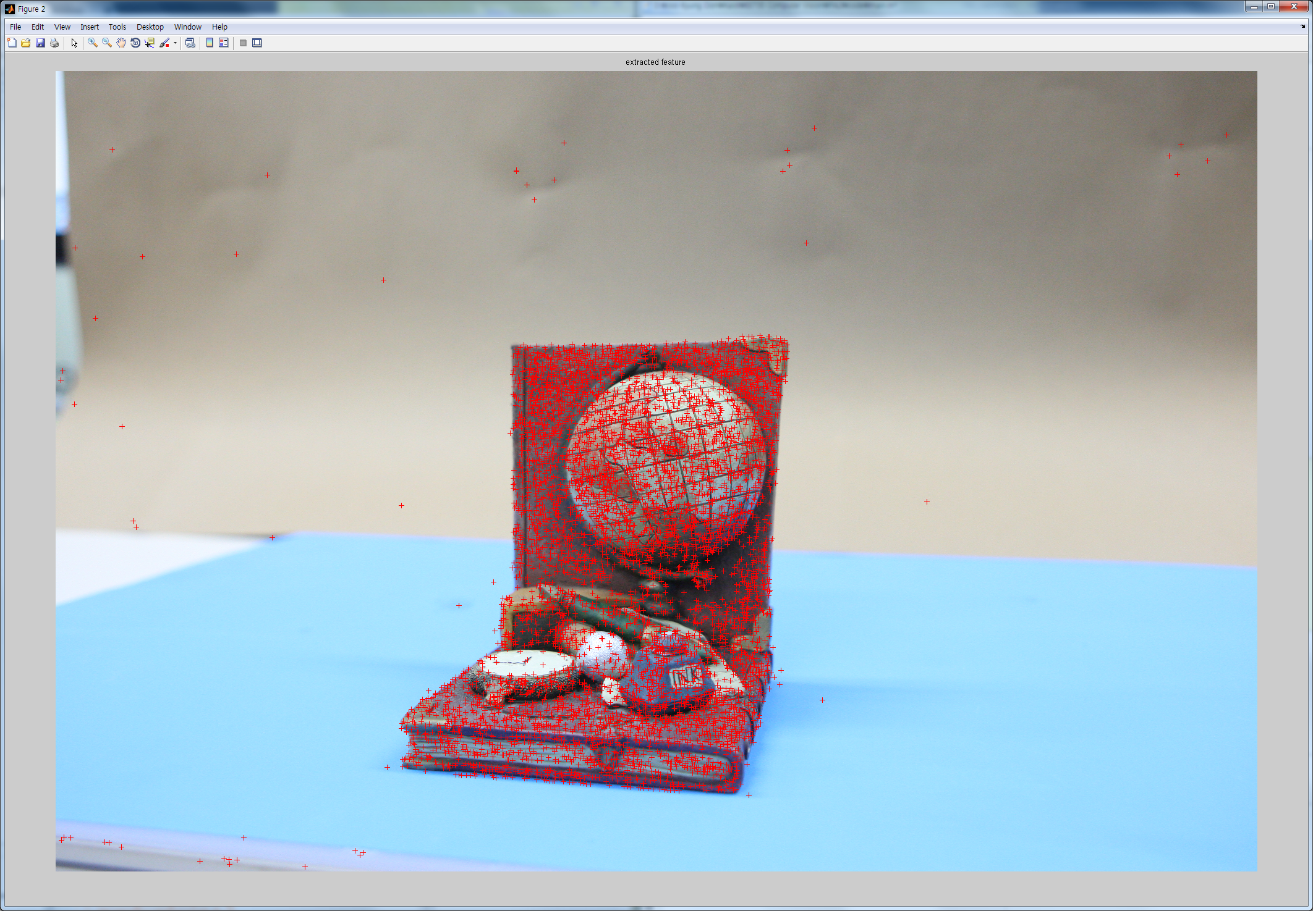
Overall Strategy
Feature extraction
cv2.SIFT_create().detectAndCompute
Extract keypoints and descriptors from a image (red points on images)
Feature Extraction
Notes:
Here are the details of the whole process:
Let me explain these things slowly.

Slide 21
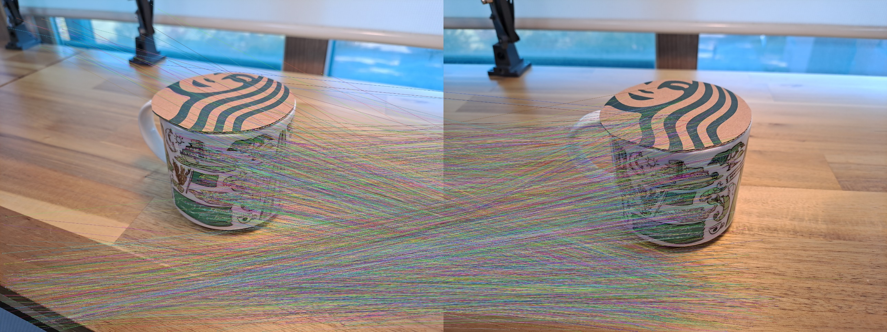
Overall Strategy
Feature matching
cv2.BFMatcher().knnMatch
Match keypoints according to descriptors between two images
Feature matching
Notes:
Here are the details of the whole process:
Let me explain these things slowly.

Slide 22
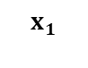
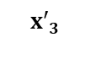
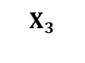
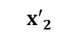
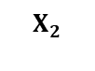
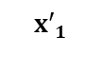
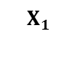
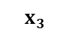
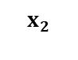
Overall Strategy
1-2. estimate a camera pose of a selected image using 3-point PnP RANSAC
Estimate Camera matrix ‘P’(Cam3) given a set of match points(red lines) and 3D {x, X}
Use the functions ‘PerspectiveThreePoint’ or ‘cv2.solveP3P’
$$X_{2}$$
$$X_{1}$$
$$X_{3}$$
New_image
$${x′}_{2}$$
$$x_{2}$$
$${x′}_{1}$$
$${x′}_{3}$$
$$x_{1}$$
$$x_{3}$$
Cam3
Cam2
Cam1
Notes:
Here are the details of the whole process:
Let me explain these things slowly.

Slide 23
Overall Strategy
1-2. estimate a camera pose of a selected image using 3-point PnP RANSAC
The output rotation vector is not 3x3 matrix, it is in Rodrigues form.
You should translate it into 3x3 matrix using cv2.Rodrigues
Notes:
Here are the details of the whole process:
Let me explain these things slowly.

Slide 24
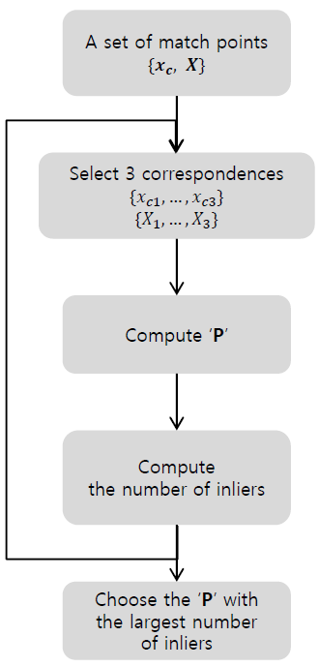
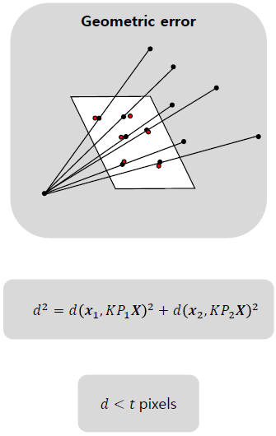
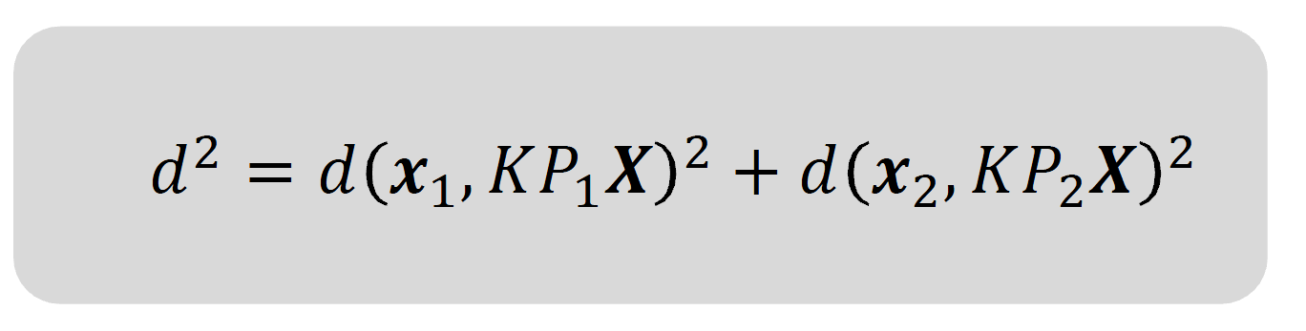
Overall Strategy
1-2. estimate a camera pose of a selected image using 3-point PnP RANSAC
Compute the number of inliers
Choose the best P with the largest number of inliers
Pixel distance
Set proper threshold
Notes:
Here are the details of the whole process:
Let me explain these things slowly.

Slide 25
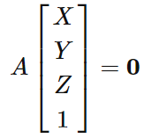
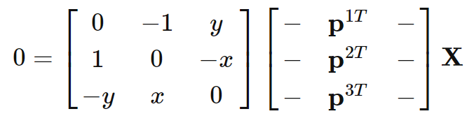
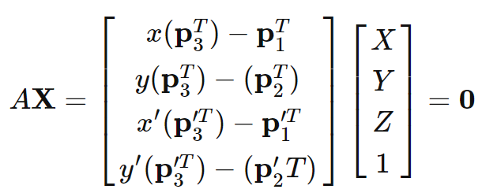
Overall Strategy
1-3. reconstruct 3D points from keypoints from the selected image using triangulation
Reconstruct 3d points of matched keypoints using two camera poses
$$X_{2}$$
$$X_{1}$$
$$X_{3}$$
$${x′}_{2}$$
$$x_{1}$$
$$x_{2}$$
$${x′}_{1}$$
$${x′}_{3}$$
$$x_{3}$$
Cam2
Cam1
See this link for more explanation
Notes:
Here are the details of the whole process:
Let me explain these things slowly.

Slide 26
Overall Strategy
1-4. repeat 1-1~1-3 until every images is included
Notes:
Here are the details of the whole process:
Let me explain these things slowly.

Slide 27
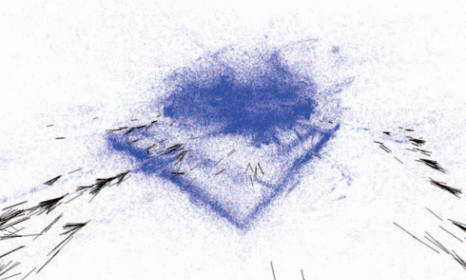
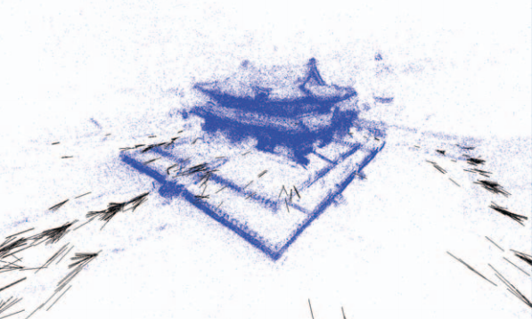
Overall Strategy
2. Do Bundle Adjustment to refine 3D reconstruction
Bundle adjustment
Refines a visual reconstruction to produce jointly optimal 3D structure and viewing parameters
‘Bundle’ refers to the bundle of light rays leaving each 3D feature and converging on each camera center.
Before Bundle adjustment
After Bundle adjustment
[6] Triggs, Bill, et al. "Bundle adjustment—a modern synthesis." International workshop on vision algorithms. Springer Berlin Heidelberg, 1999.
[7] Jeong, Yekeun, et al. "Pushing the envelope of modern methods for bundle adjustment."
IEEE transactions on pattern analysis and machine intelligence (2012): 1605-1617.
Notes:
Here are the details of the whole process:
Let me explain these things slowly.

Slide 28
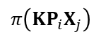
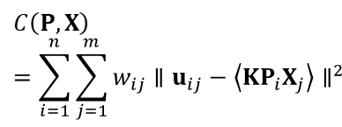




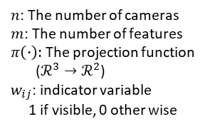
Step VI. Optimization
Bundle Adjustment’s Mathematical Problem
Minimize re-projection error manipulating 3D points and Camera poses
Non-linear Least Square approach
Re-projected point
$$X$$
Objective function
$$π\left(KP_{i}X_{j}\right)$$
$$C\left(P,X\right)=\sum_{i=1}^{n}{\sum_{j=1}^{m}{w_{ij}∥u_{ij}−\left\langle KP_{i}X_{j}\right\rangle ∥^{2}}}$$
$$×$$
$$u_{ij}$$
$$P$$
$n$: The number of cameras
$m$: The number of features
$π\left(∙\right):$ The projection function
($ℛ^{3}→ℛ^{2}$)
$w_{ij}$: indicator variable
1 if visible, 0 other wise
Re-projection error
Image plane
Notes:
Bundle Adjustment calculates the reprojection error with the matching 2d pixel after projecting all 3d points observed by the camera.
After that, the pose and 3d points are optimized by calculating the gradient in a way that minimizes it.
Repeat this several times until convergence.
Bundle Adjustment는 카메라에서 관측된 모든 3d points들을 사영 시킨뒤, 이에 매칭된 2d pixel과의 reprojection error를 계산합니다.
이후 이를 최소화 하는 방식으로 gradient를 계산하여 pose와 3d points를 최적화 합니다.
이를 수렴할때까지 여러번 반복합니다.

Slide 29

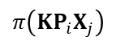



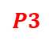

Step VI. Optimization
Project all 3D points to its visible image plane
Re-projected point
$$X$$
(all points, all camera poses)
$$π\left(KP_{i}X_{j}\right)$$
…
$$×$$
$$u_{ij}$$
$$P1$$
$$×$$
Re-projection error
$$×$$
Image plane
$$P3$$
$$P2$$
Notes:
Bundle Adjustment calculates the reprojection error with the matching 2d pixel after projecting all 3d points observed by the camera.
After that, the pose and 3d points are optimized by calculating the gradient in a way that minimizes it.
Repeat this several times until convergence.
Bundle Adjustment는 카메라에서 관측된 모든 3d points들을 사영 시킨뒤, 이에 매칭된 2d pixel과의 reprojection error를 계산합니다.
이후 이를 최소화 하는 방식으로 gradient를 계산하여 pose와 3d points를 최적화 합니다.
이를 수렴할때까지 여러번 반복합니다.

Slide 30
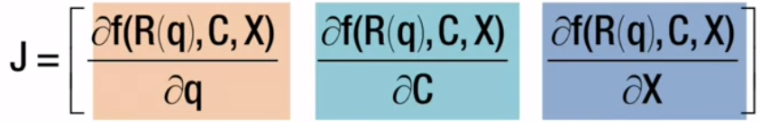
Step VI. Optimization
2. Do Bundle Adjustment to refine 3D reconstruction
JacobiancostE (Partially Provided, Matlab)
Calculates reprojection error and jacobian matrix
Jacobian Matrix
2 X 6 matrix whose (i,j) element is partial differentiation between 2d point and certain variable
f is a function to project X using camera pose(R and C) to a image plane
Notes:
In matlab, this function is implemented as lsqnonlin, and by using it, the Jacobian gradient is calculated and optimized.
Alternatively, you can optimize by calculating the Jacobian yourself.

Slide 31
Step VI. Optimization
2. Do Bundle Adjustment to refine 3D reconstruction
JacobiancostE (Partially Provided, Matlab)
A section that calculate reprojection error will be blank
fill the blank area to calculate reprojection error
A section that calculate jacobian matrix and optimization(LM2_iter_dof) will be fully provided
You have to include understanding about jacobian matrix and optimization in the report.
Notes:
In matlab, this function is implemented as lsqnonlin, and by using it, the Jacobian gradient is calculated and optimized.
Alternatively, you can optimize by calculating the Jacobian yourself.

Slide 32
Step VI. Optimization
Tips for Bundle Adjustment
How to check your BA module is working or not
Add some noise to 3D points and camera poses and do BA
Before Bundle adjustment
After Bundle adjustment
[6] Triggs, Bill, et al. "Bundle adjustment—a modern synthesis." International workshop on vision algorithms. Springer Berlin Heidelberg, 1999.
[7] Jeong, Yekeun, et al. "Pushing the envelope of modern methods for bundle adjustment."
IEEE transactions on pattern analysis and machine intelligence (2012): 1605-1617.
Notes:
In matlab, this function is implemented as lsqnonlin, and by using it, the Jacobian gradient is calculated and optimized.
Alternatively, you can optimize by calculating the Jacobian yourself.

Slide 33
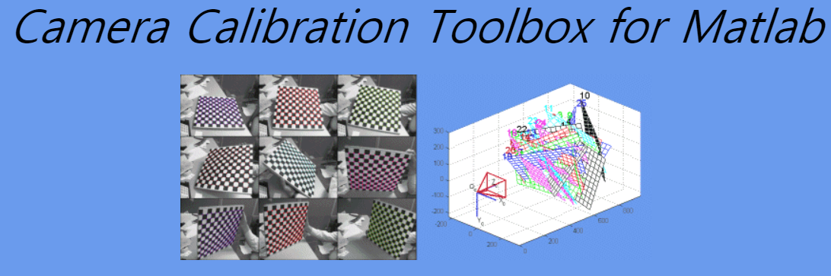

Step VII. Camera calibration (Optional, no points)
Procedure
Download camera calibration toolbox
Print checkerboard
Capture multiple images of checkerboard
Run the camera calibration toolbox
Camera Calibration using Toolbox
Matlab instruction
http://www.vision.caltech.edu/bouguetj/calib_doc/index.html
C Library
http://docs.opencv.org/doc/tutorials/calib3d/camera_calibration/camera_calibration.html
Python
https://learnopencv.com/camera-calibration-using-opencv/
Notes:
Additionally, if you calibrate your own photos and make an sfm, we will give you additional points.
Calibration is a way to obtain camera intrinsic, and you just need to shoot a grid-shaped checker board to get the camera intrinsic value.
Get the intrinsic parameters of your camera directly through the calibration method suitable for matlab/python from the link below.

Slide 34
To Do List
Two images from dataset
(Two-view)
Initialization Step
( > Three-view)
Growing Step
Bundle Adjustment
[2] Hartley, Richard, and Andrew Zisserman. Multiple view geometry in computer vision. Cambridge university press, 2003.
[3] Szeliski, Richard. Computer vision: algorithms and applications. Springer Science & Business Media, 2010.
Notes:
Here's an overview:
First of all, the object is photographed from several directions.
Then, after extracting feature points from the photographed object, they are matched.
Finally, it is the process of obtaining the pose and 3d point coordinates of two cameras using the matched points.
우선 여러방향에서 물체를 촬영합니다.
그후 촬영한 물체에서 feature point를 추출 후 , 이들을 matching합니다.
마지막으로, matching된 포인트들을 이용해 두 카메라의 pose와 3d point 좌표를 구하는 과정입니다.

Slide 35
To Do List
Select a view with the most matched features over the reference view
Implement 3 point RANSAC algorithm (4 pts)
Generate 3D point by implementing Triangulation (3 pts)
Bundle Adjustment (5 Pts)
Fill the blank of reprojection error part
Explain jacobian matrix and its optimization in your report
Make your own dataset and run your code (optional, 5 pts)
If you want to take your own image, please send me first two image input among them with corresponding calibrate parameters. Then I will give you the initial 3D model.
Notes:
Points for each course are as follows:
First, if you load two images and extract the features, you get 2 points.
After that, matching the extracted features to find correspondence is 3 points.

Slide 36
For Python Student
Not allow to use OpenCV and Scipy functions except below :
cv2.SIFT_create (Step I)
cv2.xfeatures2d.SIFT_create (Step I)
cv2.findChessboardCorners (Step VII)
cv2.cornerSubPix (Step VII)
cv2.calibrateCamera (Step VII)
cv2.solveP3P (Step V)
Image I/O function
Image visualization function
If you think other functions are mandatory, email me
Notes:
Students using python are prohibited from using other than the following functions.
This is to prevent you from doing tasks using opencv, as many functions for sfm are implemented.
If a problem is solved using a function other than the one mentioned above, the process will be treated as 0 points.

Slide 37
Provided files
Below functions and files are provided:
Data Folder: contains a image dataset and a camera intrinsic file
Functions folder: contains functions about jacobian and optimization
costE: calculate re-projection error
JacobiancostE: calculate re-projection error and jacobian matrix
Deserialize: slicing input list into rotation, translation and 3D points
JacobianPoint: calculate jacobian matrix with respect to 3D points
jacobianPose2: calculate jacobian matrix with respect to camera poses
RotationVector_to_RotationMatrix
PerspectiveThreePoint: three-points algorithm function
Notes:
Students using python are prohibited from using other than the following functions.
This is to prevent you from doing tasks using opencv, as many functions for sfm are implemented.
If a problem is solved using a function other than the one mentioned above, the process will be treated as 0 points.

Slide 38
Provided files
Below functions and files are provided:
two_view_recon_info: contains files about initial two view reconstruction
Initial two images are sfm03.jpg and sfm04.jpg
sfm03_keypoints.npy and sfm04_keypoints.npy: keypoints of sfm03 and sfm04 images
sfm03_descriptors.npy and sfm04_descriptors.npy: descriptors of sfm03 and sfm04 images
sfm03_matched_idx.npy and sfm04_matched_idx.npy: indices of matched keypoints
sfm03_camera_pose.npy and sfm04_camera_pose.npy: camera poses of two images
inlinear.npy: indices of matched points which are reconstructed in 3D
3D_points.npy: reconstructed 3D points
Notes:
Students using python are prohibited from using other than the following functions.
This is to prevent you from doing tasks using opencv, as many functions for sfm are implemented.
If a problem is solved using a function other than the one mentioned above, the process will be treated as 0 points.

Slide 39
SfM with your own dataset
Tips for making your own dataset (using your mobile phone)
1) Use a fixed-focus camera.
2) Do calibration for camera parameter estimation using toolbox (to get intrinsic).
3) Take pictures of your target scene with the camera of which the intrinsic parameter is known now.
4) Run your SfM program with your dataset by replacing the images and the camera intrinsic matrix K to yours.
Notes:
This is about the two extra points I just mentioned.
You can obtain an intrinsic by calibrating the photos taken with the mobile phone camera through the toolbox,
and then implement SfM through this.

Slide 40

Display your 3D results (ply file)
Use Meshlab (download: http://www.meshlab.net)
Notes:
After saving the final result 3d point,
you can visualize it through meshlab program by saving it in .ply format.

Slide 41
Submission
Submission should include…
Source code
Results (3D point cloud in ply file) of your code
Readme file explaining how to execute the program
Report (3pts)
Report should include…
Your understanding of each steps of algorithms
Figures of results from your implementation
Understanding of jacobian matrix and optimization
Notice
[Delayed submission] Not allowed
[Plagiarism] Definitely F grade for copied codes (from friends or internet)
[Implementation] No use any open function such as findFundamentalMat() other than the mentioned function
Due : Nov. 4, 11:55PM
To : LMS System
TA session: 10/30 and 11/1
TA: Seongmin Lee
Office Hour : Thu, Fri PM 2:30~3:30
(e-mail: sungmin9939@gm.gist.ac.kr)
Notes:
The files you are submitting are:
Also, late submission of assignments is not allowed.
And we'll run the plagiarism checker to check if you've copied a friend's or senior's code.
Students who plagiarize the code will be given an F grade.
Also, it is forbidden to use anything other than the opencv function just mentioned.
This course is for you to study while writing sfm yourself.

Slide 42
Auxiliary References
Multiple-View Geometry in Computer Vision (https://github.com/liulinbo/slam/blob/master/Multiple%20View%20Geometry%20in%20Computer%20Vision.pdf)
Basic Projective Geometry (ch. 2,3)
Camera Models and Calibration (ch. 6,8)
Epipolar Geometry and Implementation (ch. 9, 11)
Triangulation (ch. 12)
Computer Vision: Algorithms and Applications (http://szeliski.org/Book/drafts/SzeliskiBook_20100903_draft.pdf)
Structure from Motion (ch. 7)
Phillp Torr’s Structure from Motion toolkit
Includes F-matrix estimation, RANSAC, Triangulation and etc.
https://kr.mathworks.com/matlabcentral/fileexchange/4576-structure-and-motion-toolkit-in-matlab
Notes:
These are additional references.
If you would like to study further, please see the resources below.
다크프로그래머 geometry
채점
Ply 제출
보고서에 Essential, RT 명시
예시 ply 보내기
정 essential이 안나오면 기븐 함수 사용?

